Slide 1
CS5031 Assignment3 Group 7
Honglin Zhang Jiaxin Wang Xinya Gong

Slide 2


Estate Agency System
Multi-user online house sale management system

Slide 3
Data structure
Building
building_id (p_key)
building_name
building_address
Flat
flat_id (p_key)
building_id (p_key, f_key)
flat_name
user_id (f_key)
flat_area
flat_sold_out_date
flat_price
User_Permission
user_id
peimission_id
User
ser_id (p_key)
user_name
user_phone
user_email
user_address
user_position(admin, manager, customer)
Permission
permission_id
permission_url

Slide 4
Technologies
Front-end
GUI Client
React + UI framework
Axios (an Ajax framework supported in React)
Terminal Client
Back-end
Spring Boot
Maven
Swagger + Postman
Spring Security (Authentication and Authorization)
MySQL (structured database, storing data) + MybatisPlus
Redis(key-value database, storing token)

Slide 5
Developing
Design Pattern
MVC: Model + View(GUI + Terminal) + Controller
Model
Service
Model
Entity
Mapper
System Architecture
1. GUI -> Controller -> Service(Logic) -> Mapper -> Entity
2. Terminal -> Service(logic) -> Mapper -> Entity (First developing way)
2. Terminal -> Controller -> Service(logic) -> Mapper -> Entity (Second developing way)

Slide 6
Developing
Task Assignment
Xinya Gong: GUI + API(Front-end)
Jiaxin Wang: Terminal -> Service + Service test
Honglin Zhang: Controller -> Service(logic) -> Mapper -> Entity + Service test
Together: The designing of authentication and authorization

Slide 7
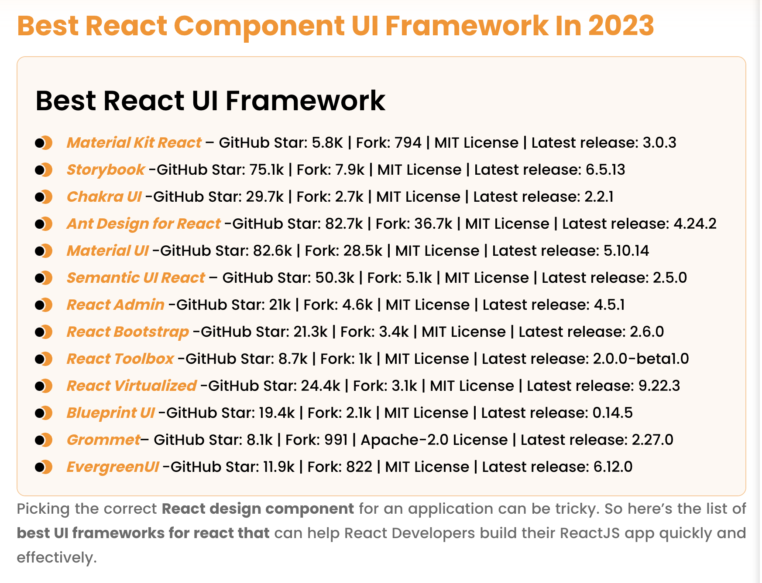
Some React UI Framework

Slide 8
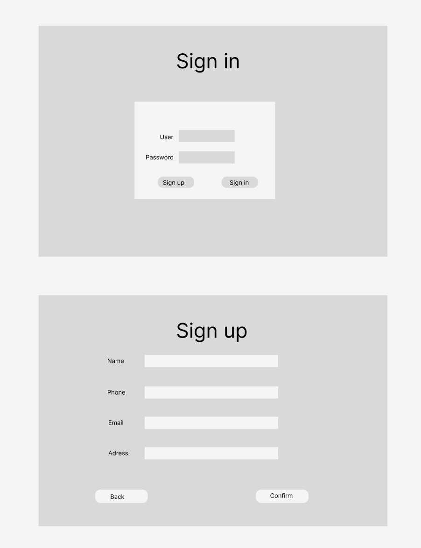
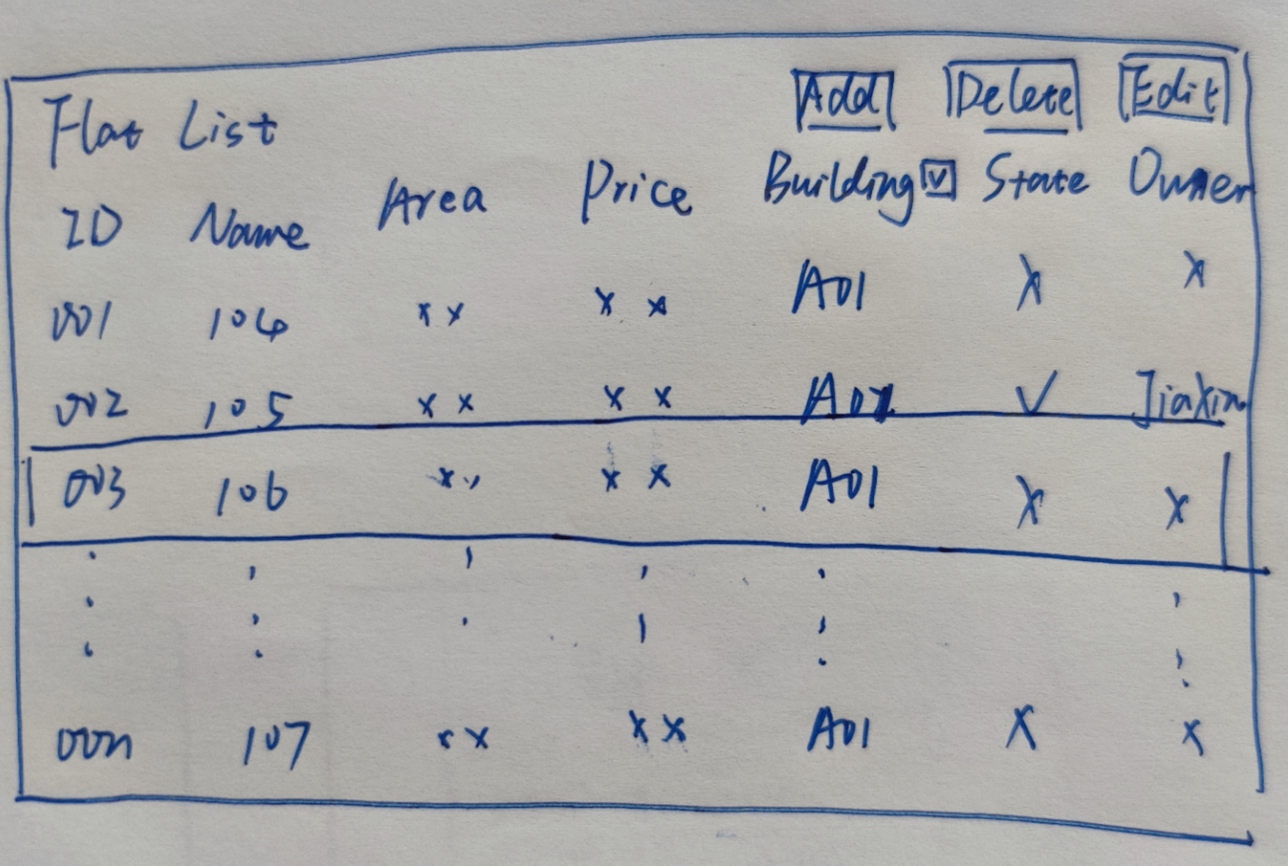
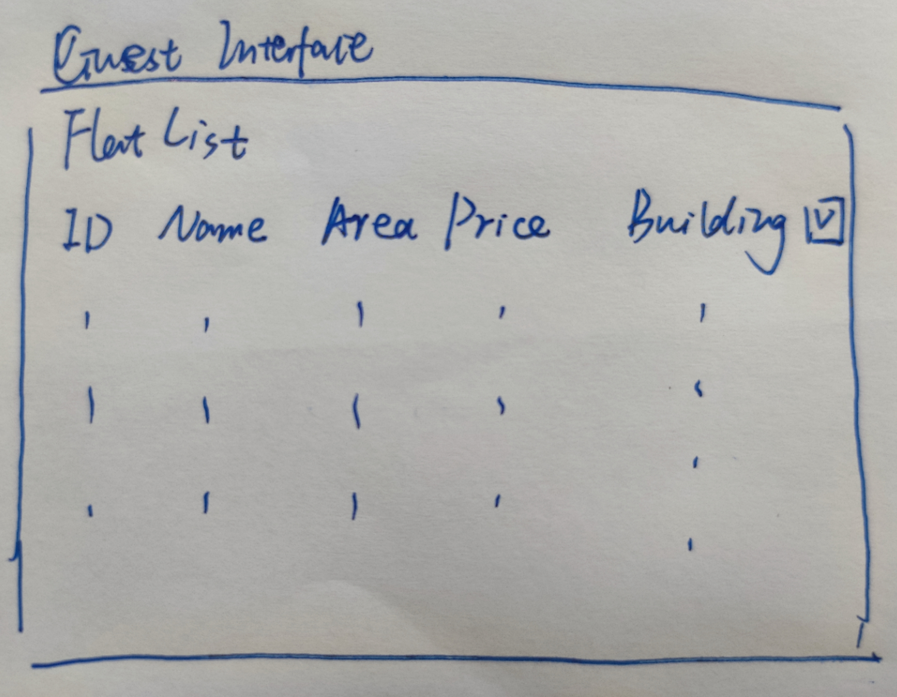
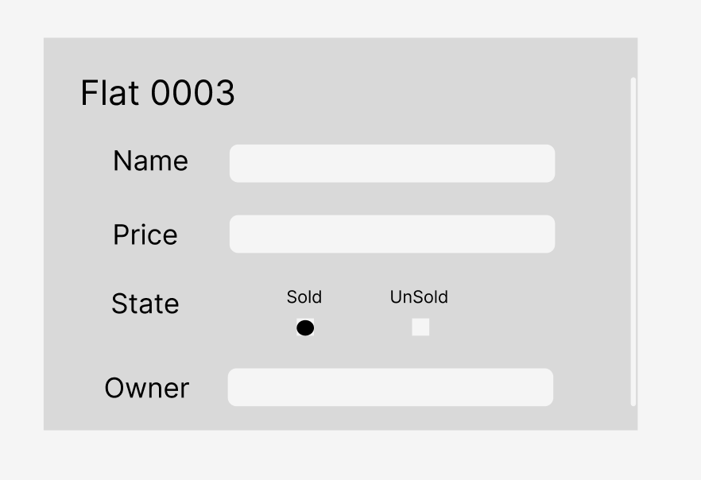
UI prototype

Slide 9
What’s happened so far
Meeting 1
Brainstorm
Technologies
Meeting 2
Finalize topic
Database structure
Task assignment

Slide 10
Time estimate for each task
GUI: 7 days
Controller: 2 days
Terminal: 2 days
Service + Mapper: 4 days
Report: 3 days

